Slide 1
THE ELDERLY IN TURKEY AND THE IMPACT OF THE PANDEMIC
Murat GÜRKAN
Dursun UÇAN
İlkay Elif ÖZALP
International Association of Great Educators and Special Educators

Slide 2
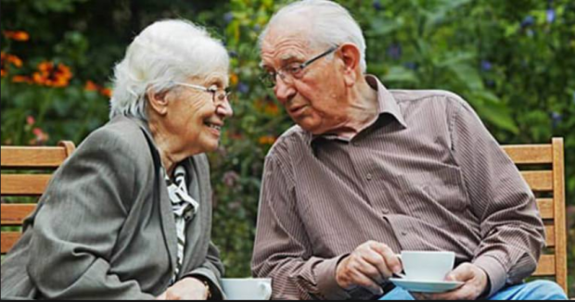
WHAT IS OLD?
Individuals aged 65 and older in the world are defined as the "old population".

Slide 3
POPULATION INCREASE RATE AND 65+ POPULATION RATE IN TURKEY BY YEARS
TURKEY- Demographics
Year | Populatıon | Yearly Populatıon Increase Rate (%) | Age 65+ Populatıon Rate (%)
1935 | 16,158,567 | 2.29 | 3.9
1945 | 18.790.987 | 1.08 | 3.3
1955 | 24,065,543 | 2.97 | 3.4
1965 | 31,391,651 | 2.62 | 4.0
1975 | 40,348,789 | 2.66 | 4.6
1985 | 50,664,654 | 2.64 | 4.2
1990 | 56,473,653 | 2.29 | 4.3
2000 | 67,804,543 | 2.00 | 5.7
2007 | 70,586,256 | 0.58 | 7.1.
2012 | 75,627,384 | 1.20 | 7.5
2015 | 78,741.53 | 1.34 | 8.2
2020 | 83,614,362 | 0.55 | 9.5

Slide 4
THE NUMBER OF THE 5-YEAR OLD POPULATION IN TURKEY BETWEEN 2015-2020
YEAR | Age group | CIVIL REGISTRY | Percentage of population
2015 | 65-69 years | 2,356,385 | 2.82%
2015 | Age 70-74 | 1.626.184 | 1.94%
2015 | Age 75-79 | 1,183,746 | 1.42%
2015 | 80-84 Age | 810,488 | 97%
2015 | Age 85-89 | 390,450 | 47
2015 | Age 90+ | 127,986 | 15%
 |  | 6,495,239
While the population aged 65 and over was 6 million 495 thousand 239 people in 2015, it increased by 22.5% in the last five years and reached 7 million 953 thousand 555 people in 2020.
While the proportion of the elderly population in the total population was 8.2% in 2015, it increased to 9.5% in 2020. In 2020, 44.2% of the elderly population was male and 55.8% was female.
YEAR | Age group | CIVIL REGISTRY | Percentage of population
2020 | 65-69 years | 2,938,715 | 3.51%
2020 | Age 70-74 | 2,131.705 | 2.55%
2020 | Age 75-79 | 1,355,346 | 1.62%
2020 | 80-84 Age | 861,199 | 1.03%
2020 | Age 85-89 | 466,748 | 56%
2020 | Age 90+ | 199,842 | 24%
 |  | 7,953,555

Slide 5
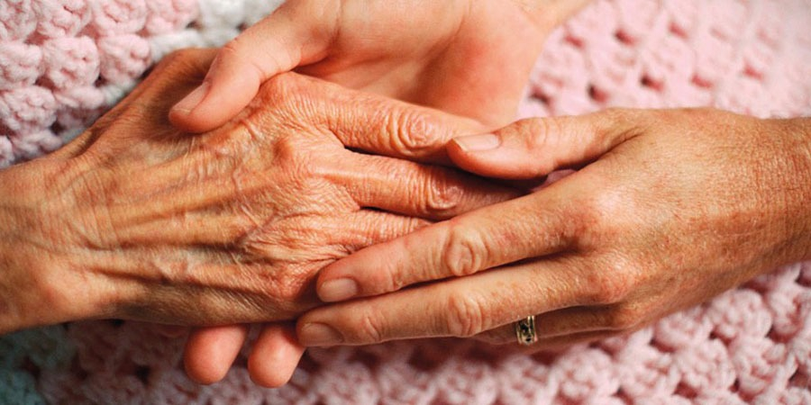
SPECIAL STUDIES ON THE ELDERLY IN TURKEY
Studies in the field of aging in Turkey gained momentum in the mid-2000s.

Slide 6
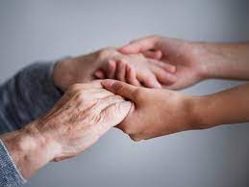
SPECIAL STUDIES ON THE ELDERLY IN TURKEY
The Situation of the Elderly in Turkey and Aging National Action Plan” was prepared in 2007 by the Ministry of Development (Abolished State Planning Organization).
Prepared by the Ministry of Family and Social Policies, General Directorate of Services for the Disabled and Elderly.

Slide 7
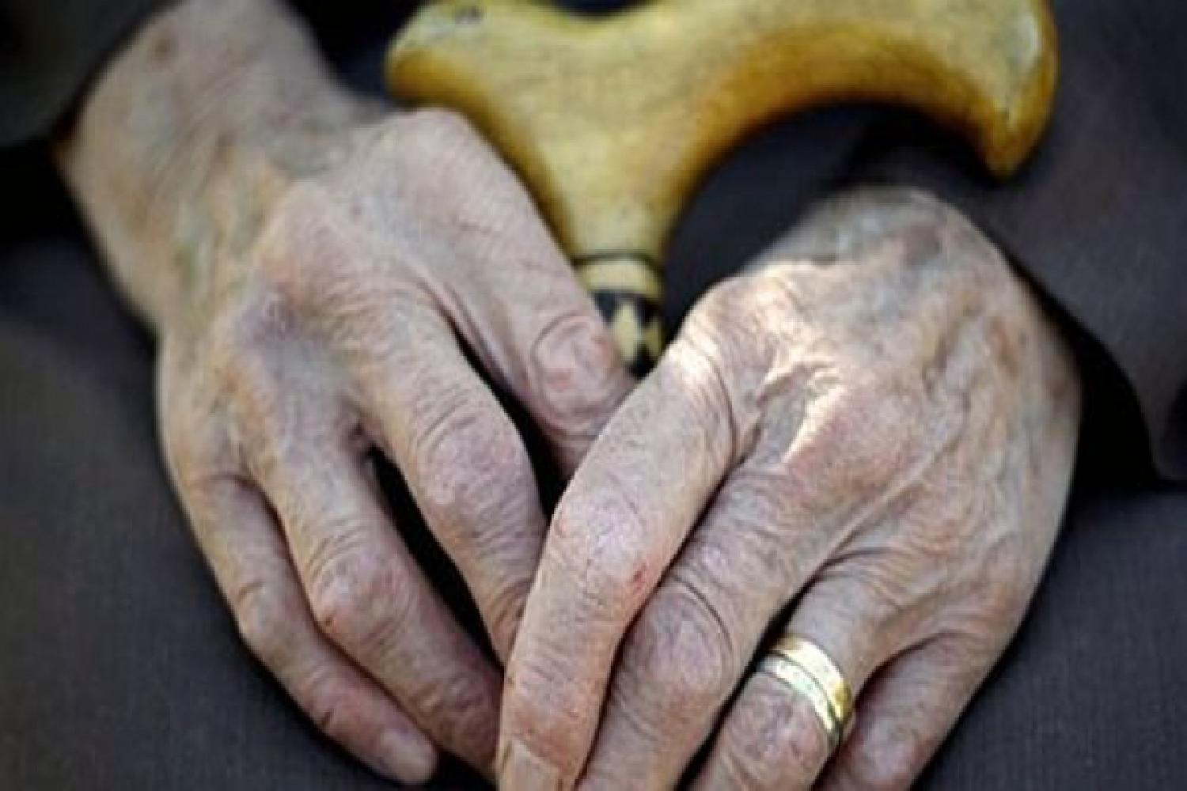
SPECIAL STUDIES ON THE ELDERLY IN TURKEY
“Aging Specialization Commission”
10 by the Ministry of Development. It was created within the scope of the Development Plan (2014-2018) studies. This commission determined urgent strategies for aging and long-term care.

Slide 8
SPECIAL STUDIES ON THE ELDERLY IN TURKEY
“Care Services Strategy and Action Plan (2011-2013)”
In the social security system by the General Directorate of Disabled and Elderly Services of the Ministry of Family and Social Policies; The work on the care assurance model and the creation of care insurance has been initiated.

Slide 9
SPECIAL STUDIES ON THE ELDERLY IN TURKEY
Healthy Aging Action Plan and Implementation Program in TURKEY (2015-2020)”
Prepared by the Turkish Ministry of Health, Public Health Institution of Turkey in 2015

Slide 10
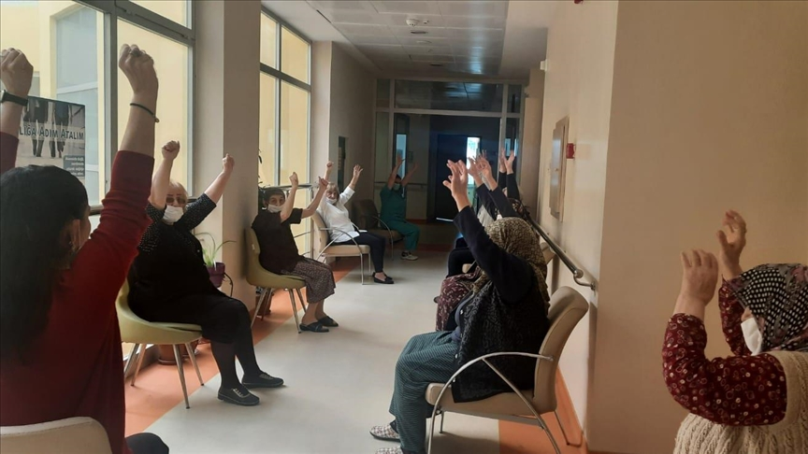
SPECIAL STUDIES ON THE ELDERLY IN TURKEY
“Active Aging Strategy Document (2017-2020)”
It was carried out by the Ministry of Family and Social Policies, General Directorate of Services for the Disabled and Elderly, by universities, local governments, public institutions and non-governmental organizations.

Slide 11
SOCIAL POLICIES FOR THE ELDERLY IN TURKEY
Social Policies

Slide 12
The perspectives of societies on the old age period and the aging process are often reflected in social policies and also determine the form and future of the services to be provided to the elderly on the basis of social inclusion.
Social Policies
Physical Dimensions of Aging
Social Dimensions of Aging
SOCIAL AGING

Slide 13
1. Old Age Pension Under the Law No. 2022
As of 2021, the old-age pension is 864.89 liras within the scope of Salary to the Needy, Powerless and Orphaned Turkish Citizens who are over the age of 65. In 2020, nearly 820,933 people benefited from old age pension.
2. Disabled and Elderly Home Care Service
Year | No. of Accessible Rooms | Payment Amount (Million TL)
2020 | 535,805 | $9,474

Slide 14
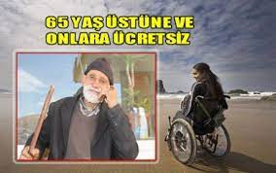
3. Free Travel Rights
In the ninth paragraph added by Law No. 6637; It is a service that covers the operators of each transportation vehicle and private sea transportation vehicle that provides urban public transportation services belonging to private individuals or companies authorized by the municipalities, which have the obligation to travel free of charge.
Year | Transferred Allowance (TL)
2020 | 218,275,890

Slide 15
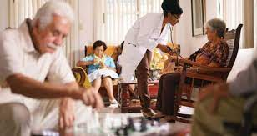
4. Nursing homes
Number of elderly people aged 60 and over staying in state nursing homes
Years | Number of Nursing Homes | Capacity | Number of Elderly Cared for
2021 (February) | 162 | 16,466 | 13.970
2020 | 158 | 15,975 | 13.970
2019 | 153 | 15,385 | 13,888
2018 | 146 | 14,967 | 13,883
2017 | 144 | 14.793 | 13,692

Slide 16
5. Residential Care (Peace) Centers
The number of nursing homes owned by public, private and other public institutions and the number of elderly people cared
Residential care nursing homes 2021 (February) | Nursing home care Numbers | person being cared for Numbers
State Affiliated Nursing Homes | 162 | 13.970
State Hospice (Elderly) | 1 | 458
Nursing Homes Owned by Other Public Institutions | 22 | 1941
Private Nursing Homes | 262 | 10,744
TOTAL | 445 | 27,571
State Affiliated Nursing Homes Elderly Living Centers Included in Its Capacity | 25 | 90
Daytime Organizations | 31 | 382

Slide 17
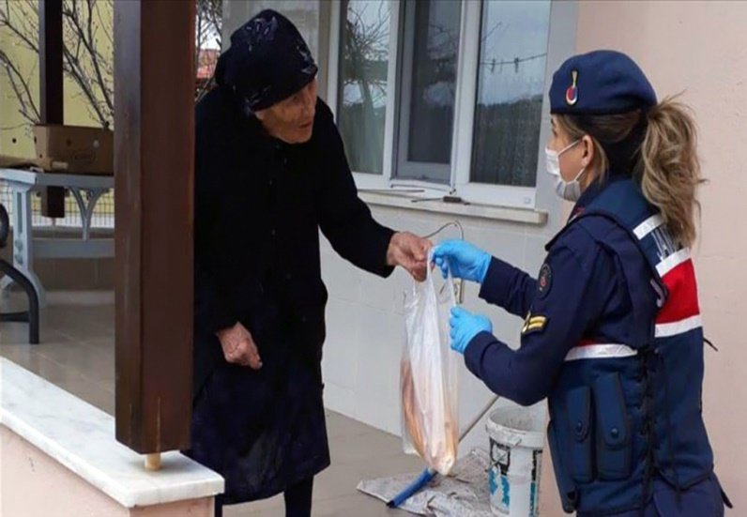
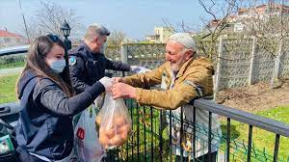
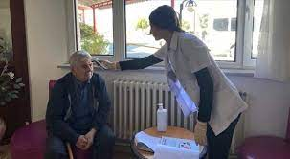
COVID-19 STUDIES ON THE ELDERLY IN TURKEY
Social Policies

Slide 18
COVID-19 STUDIES ON THE ELDERLY IN TURKEY
After 24.00 on March 21, 2020, our citizens aged 65 and over are prohibited from going out of their residences, walking around in open areas, parks and traveling by public transportation vehicles, in order to protect themselves from COVID-19.
Social Policies
Our elderly people who are within the scope of the ban can leave the house and travel by obtaining permission when necessary.

Slide 19
COVID-19 STUDIES ON THE ELDERLY IN TURKEY
Vefa Social Support Groups have been established to meet the needs of our citizens aged 65 and over under the presidency of governors / district governors in order to meet the basic needs of our citizens aged 65 and over who live alone and have no relatives to meet their needs.
Social Policies
An application has been started to ensure that our citizens, who have been restricted/prohibited from leaving their residence, can report their needs and meet their needs via the numbers 112, 155, 156.

Slide 20
COVID-19 STUDIES ON THE ELDERLY IN TURKEY
In case our elderly people in need of Social Assistance (economic support) are notified of their economic support applications to the phone number 144 belonging to the Ministry of Family, their demands are evaluated and economic support is given to those in real need.
Social Policies
The declarations and payments of our taxpayer citizens over the age of 65 and who cannot go out due to their chronic illness have been postponed until the end of the ban.

Slide 21
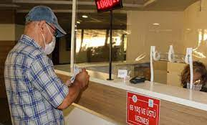
COVID-19 STUDIES ON THE ELDERLY IN TURKEY
Public banks have allowed retirees to pay their salaries at home if they wish.
Social Policies
The minimum pension amount was increased from 1,000 TL to 1,500 TL. It has been ensured that the elderly care institutions continue to serve in such a way that they are among the sectors to be evaluated within the scope of force majeure.

Slide 22
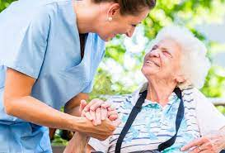
COVID-19 STUDIES ON THE ELDERLY IN TURKEY
It has been ensured that the elderly care institutions continue to serve in such a way that they are among the sectors to be evaluated within the scope of force majeure.
Social Policies
In order to provide care services in the care centers, the possibility of not seeking the income criterion for three months has been introduced, and the President can extend this period up to one year, if necessary, and it has been ensured that our elderly people who need it during the COVID-19 process can be taken into institutional care free of charge, regardless of their wages.

Slide 23
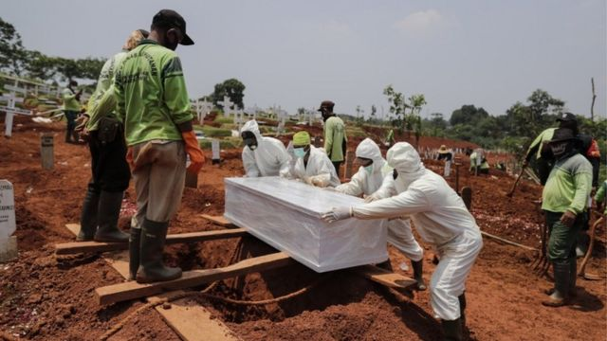
65+ AGE COVID-19 VACCINATION AND DEATH RATE IN TURKEY
Social Policies

Slide 24
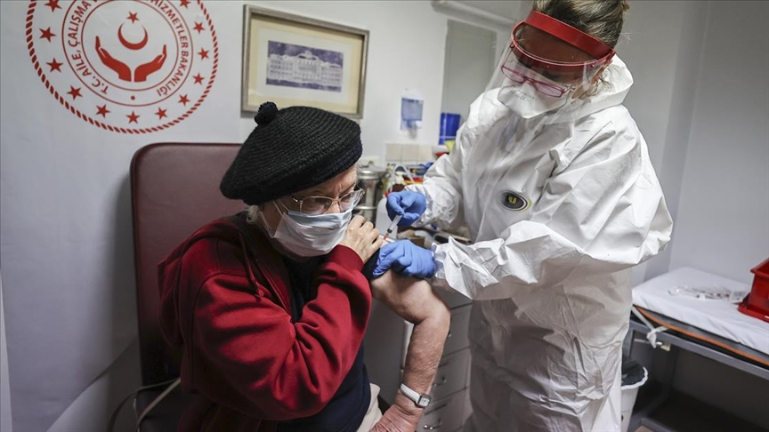
As of January 14, 2021, vaccination studies for people over 65 years of age have started in Turkey. So far, 76.4% of people aged 65+ in Turkey have been vaccinated.
Social Policies
93% of those who died from Corona virus in Turkey consist of people over the age of 65+.

Slide 25
WHAT ARE THE EFFECTS OF THE COVID-19 PROHIBITS IN TURKEY ON THE ELDERLY? (through the eyes of society)
Social Policies

Slide 26
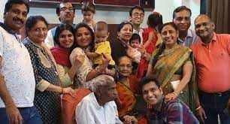
The curfew affects our elderly people who walk every day in terms of their health, and our elderly who cannot walk in this process experience problems with their health,
Social Policies
While our elderly people living with their son and daughter or relatives stay at home, the households who are constantly outside are faced with the risks of carrying the virus to their home,

Slide 27
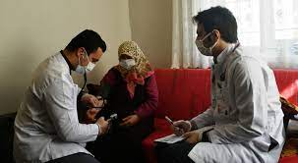
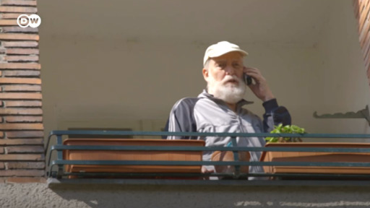
Deficiencies in the health checks and treatments of many of our citizens over the age of 65 due to the virus,
Due to the virus, our elderly people have been excluded from social life, causing their loved ones not to visit them, and they are doomed to loneliness in this process,

Slide 28
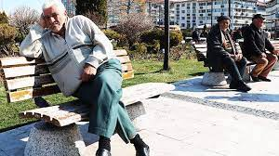
The majority of the society sees our elderly people as the group that spreads the virus and reacts negatively,
Social Policies
As a result of the prohibition of using public transportation vehicles and deprivation of their freedom of travel, the society's extreme reaction to our elderly citizens who want to use public transportation,

Slide 29
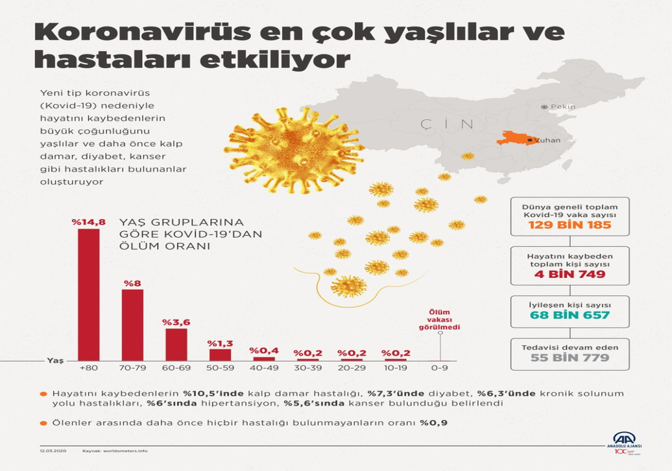
The highest number of deaths due to the virus are our elderly citizens,
Social Policies
Feeling remorseful due to the fact that they mostly cause the death of the elderly population at home as a result of catching corona virus of other individuals living with family elders and carrying viruses to the house,

Slide 30
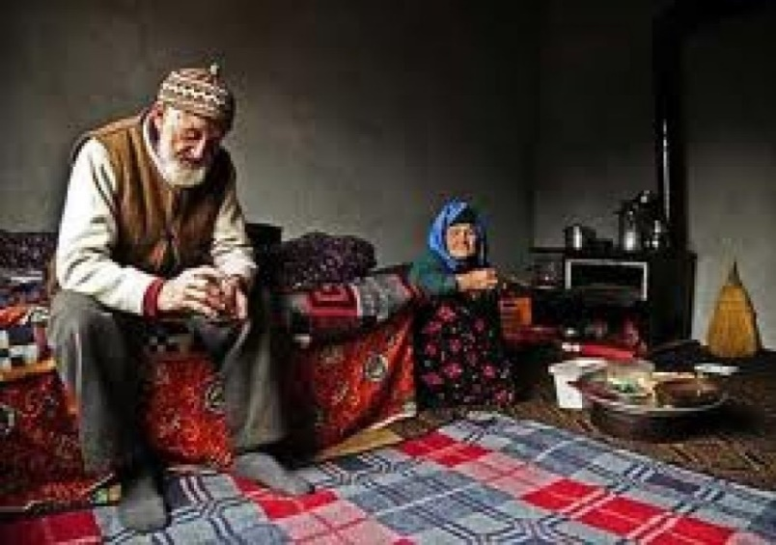
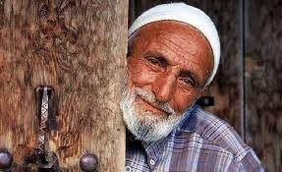
Affecting family relationships due to the change in our habits and social life, increasing loneliness of our elderly people,
Social Policies
The mirror of our past, the architects of our future, our elderly people are lonely when they need attention, love and care,

Slide 31
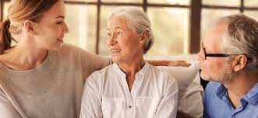
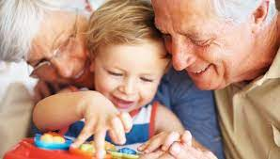
in conclusion
Social Policies

Slide 32
To Realize the Happy, Peaceful and Healthy Lives of Our Past and Future Generations.
Social Policies
We must follow the rules of mask, distance and cleaning so that we can live with our loved ones.

Slide 33
Prepared by Murat GÜRKAN Dursun UÇAN İlkay Elif ÖZALP
Social Policies
International Association of Great Educators and
Special Educators-UBED / TURKEY
www.ubed.org.tr
e-mail: ubed.tr@gmail.com

