Slide 1
THE OLDER GENERATION
Fuad Afandiyev

Slide 2
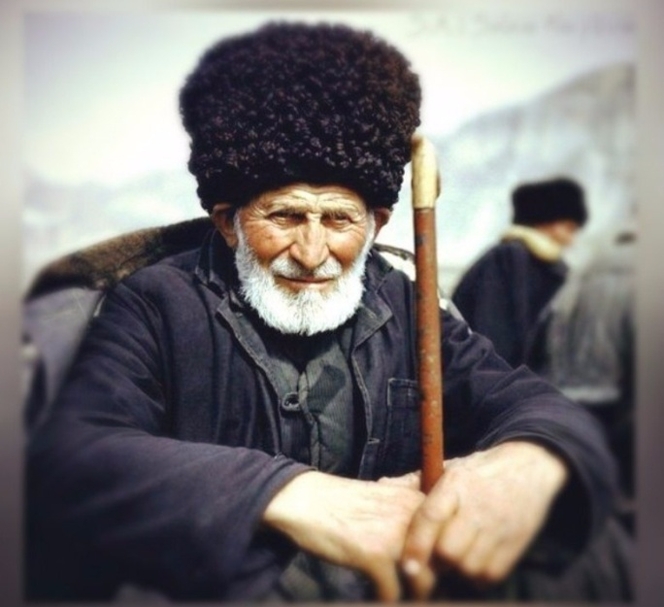
I come from the Caucasus, where the opinion of elders has been respected since ancient times and the elderly people are taken care of. I was born in Azerbaijan in the city of Baku into a full-fledged family. Not only my mom and dad were involved in my upbringing, but also my beloved grandparents. By teaching me to value and respect the older generation, they made a great contribution to my upbringing and culture

Slide 3
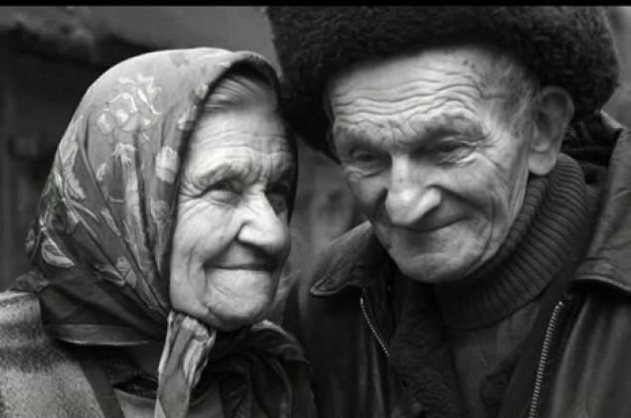
Today we are faced with the problem of the quality of life of the elderly. It hurts to realize, but each of them needs something. Someone needs health, someone cannot cope with loneliness, and someone lacks simple care and love. Absolutely every elderly person needs help, but, unfortunately, not every family and not every country can provide him with sufficient help.

Slide 4
The system of rendering assistance to the elderly by the state and non-state institutions is different in different countries. There are nursing homes, health centers or special centers for the elderly in the world, as well as many other institutions. Some countries have introduced benefits for pensioners on public transport or the purchase of medicines. There are countries where special volunteers look after the elderly. Each country tries to help the older generation and doing everything possible for this. But, unfortunately, there are still old people in the world who need help.

Slide 5
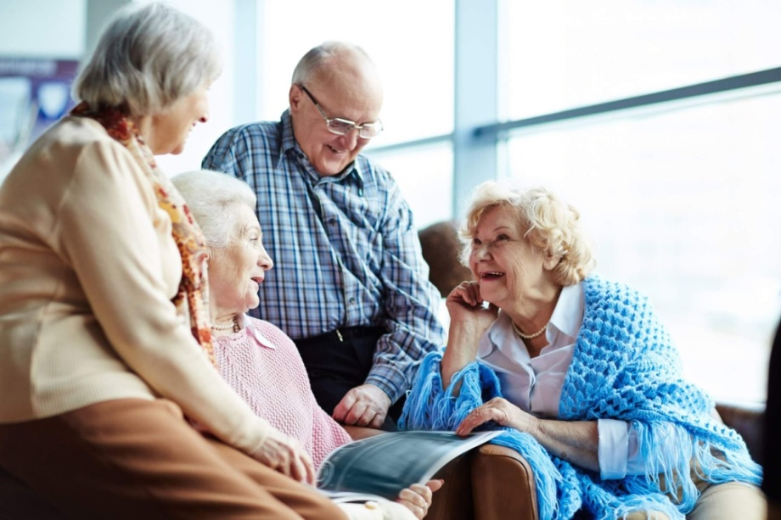
Aging is a continuous process. As grow older, a person realizes that he is not interested in something new, and he strives for stability and reliability in life. Realizing the inevitable aging, losing social status, being subject to physical limitations and mental changes, a person has a feeling of uselessness and a depressive state, as well as a narrowing of the social circle.

Slide 6
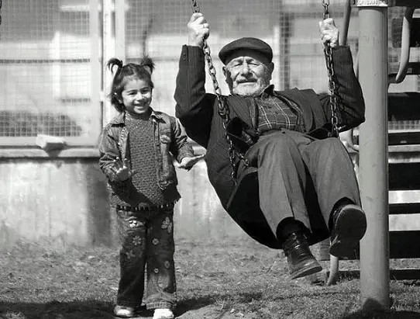
A person begins to change his lifestyle and behavior. Most older people change in an unfavorable direction. For example, as a result of a decrease in interest in life, a person's social life is limited. This leads to the fact that a person is unable to perceive something new, anxiety and suspiciousness arise, he can become irritable, touchy, greedy or capricious. We make sure that people in old age are like small children. The worst thing is that negative thoughts and emotions can lead an elderly person to depression and loneliness

Slide 7
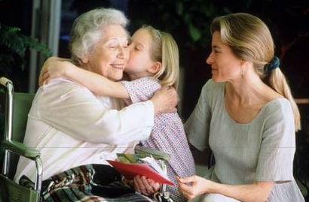
We cannot allow an aging person to change in this direction. The main solution to this problem is to maintain the quality of human life, as well as care, warmth and love. "Caring" is about not making the person feel unnecessary and aging. We need to give the elderly person what he needs. And he needs good financial and housing conditions, a healthy lifestyle, education, access to information, quality medical and social assistance, as well as mental well-being.

Slide 8
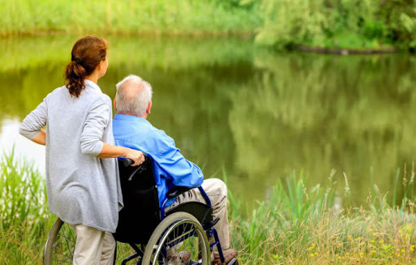
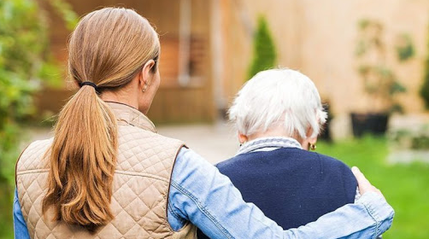
And again we are faced with the problem that not every country and not every family can provide for its elderly people, it would seem, in the most simple things. It would be a great achievement for humanity to create special centers in every corner of the world that really help people. Where they help everyone, sick people or orphans, homeless and elderly people and everyone in need. I am glad that this topic does not leave the world indifferent to these people. We already know all the problems that worried older people. And we know how to solve them. We need to act!

Slide 9
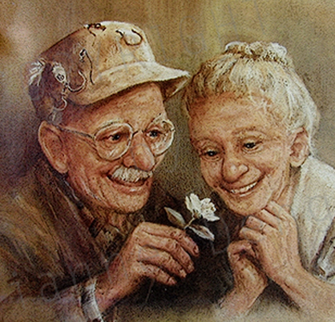
We must not forget that someday you and I will grow old. It will be so fast that we will not have time to realize it. Therefore, we must solve the problems associated with the elderly as soon as possible, so that, being elderly, we arrive in complete carelessness and in the love of others.

Slide 10
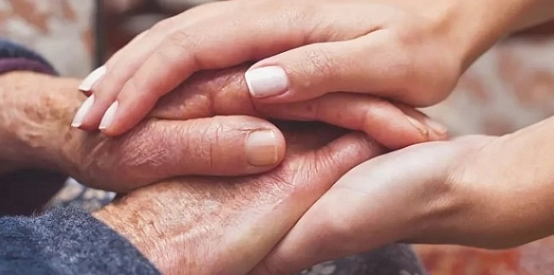
We must value, respect and help our elders, because they are our past, and without the past, humanity has no future!

